Slide 1
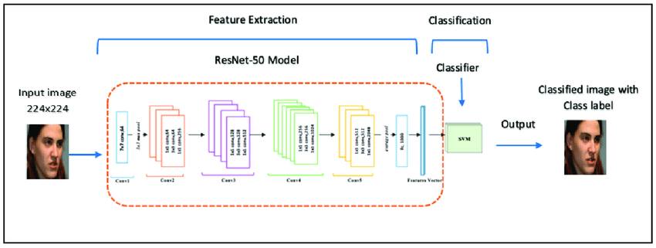
Image Classification with ResNet
Duc Dao

Slide 2
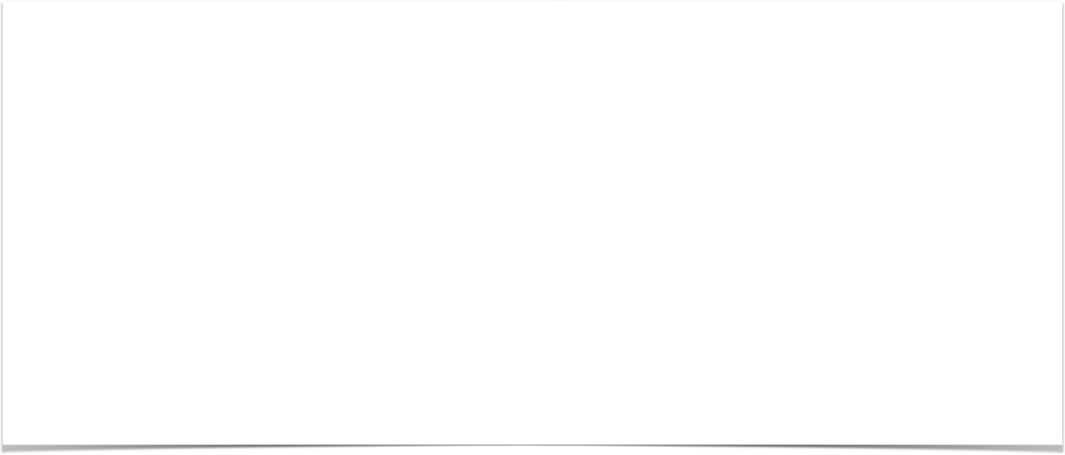

Image Classification Task
First step of vision interpretation process

Slide 3

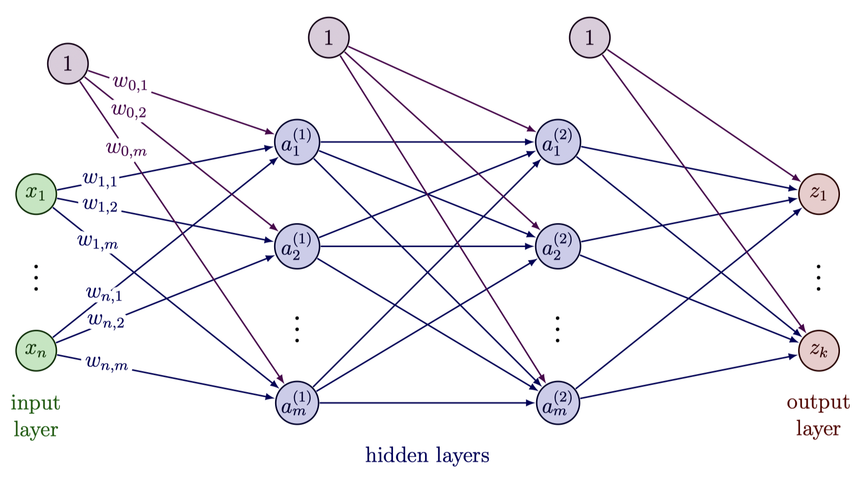
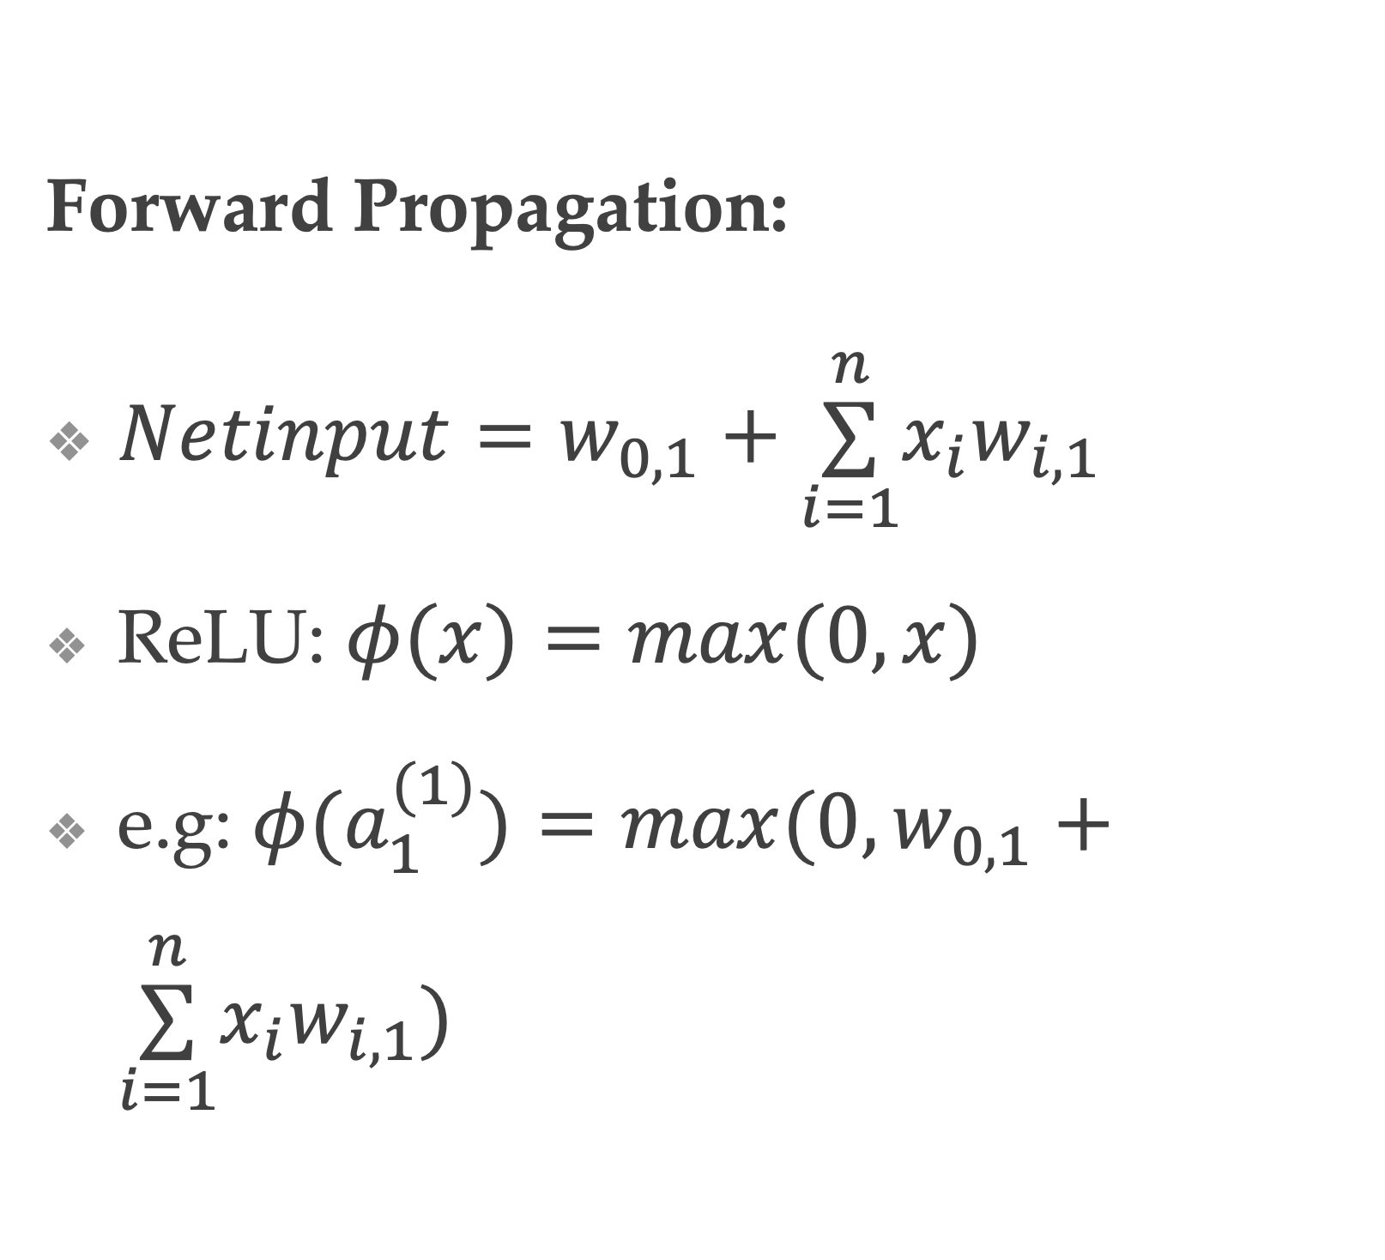
Fully Connected Network
Forward Propagation:
$Netinput=w_{0,1}+\overset{n}{\underset{i=1}{∑}}x_{i}w_{i,1}$
ReLU: $φ(x)=max(0,x)$
e.g: $φ(a_{1}^{(1)})=max(0,w_{0,1}+\overset{n}{\underset{i=1}{∑}}x_{i}w_{i,1})$

Slide 4

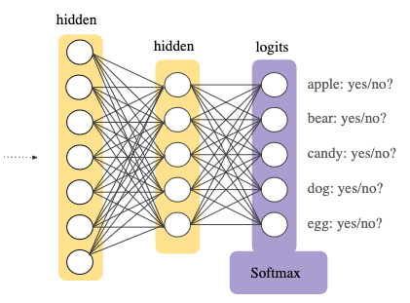

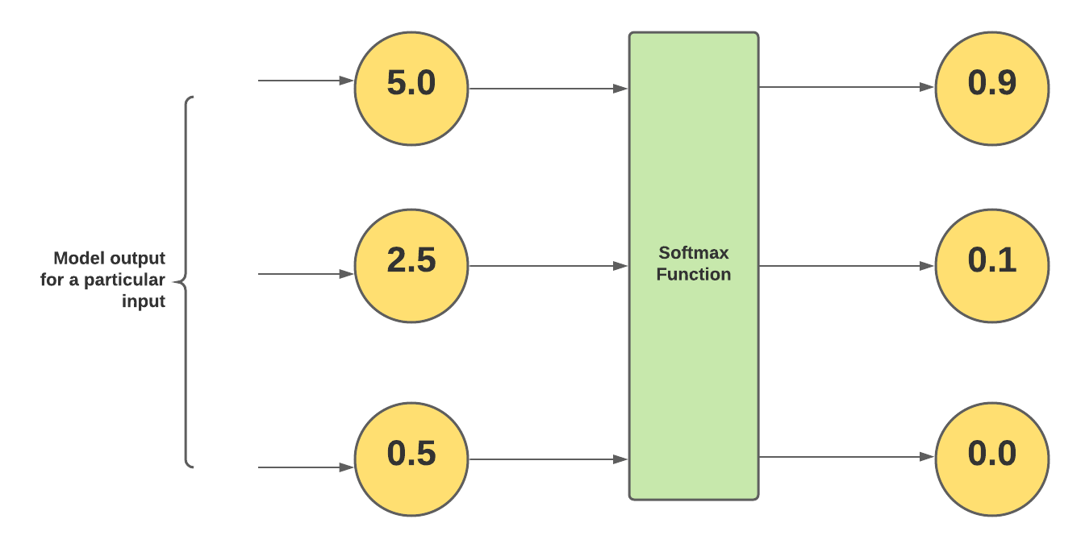
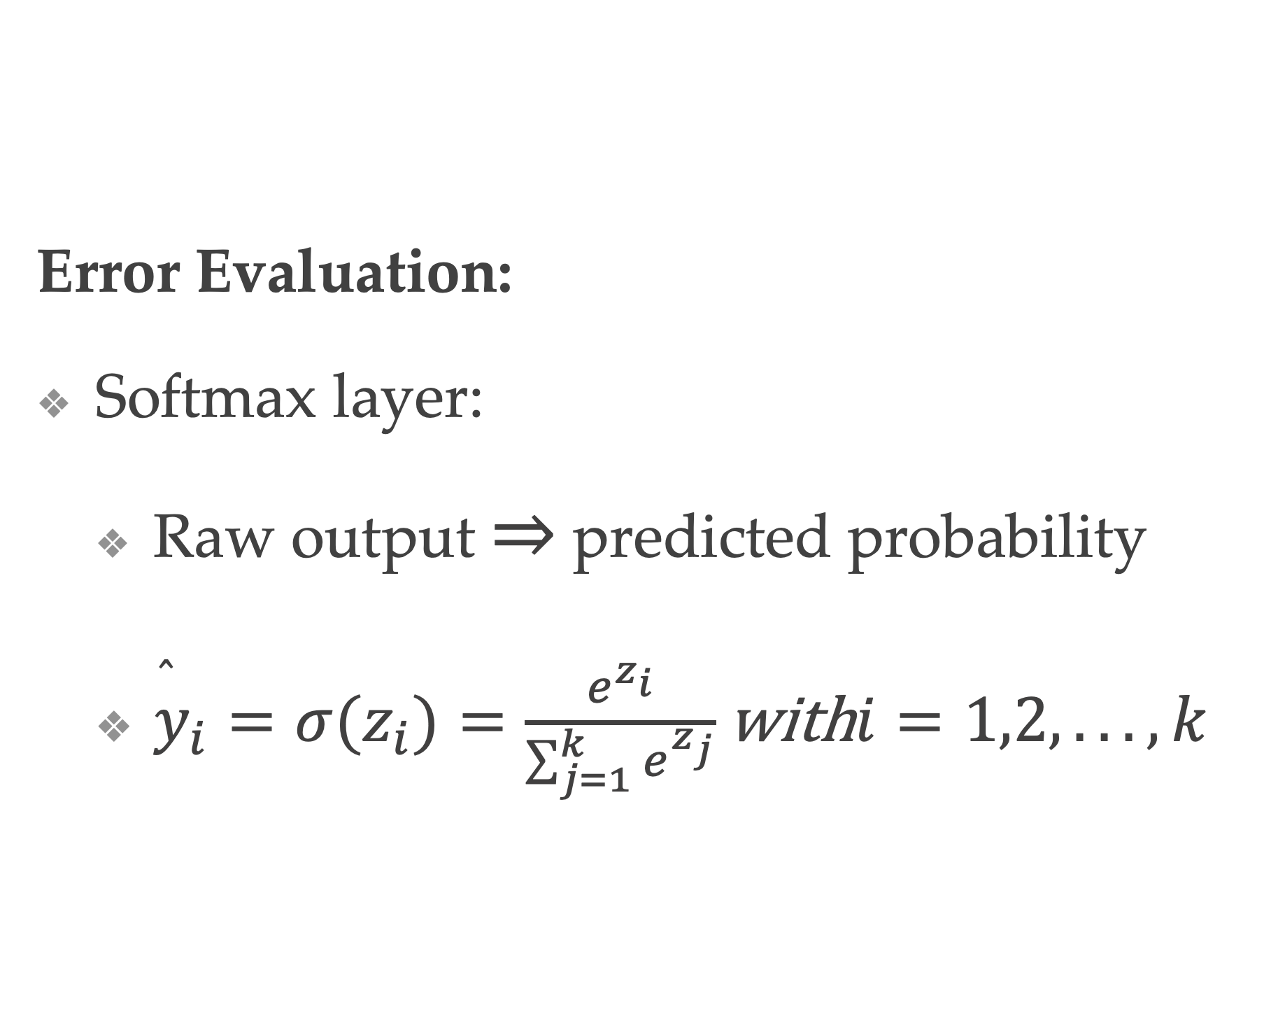
Fully Connected Network
Error Evaluation:
Softmax layer:
Raw output $⇒$ predicted probability
${\overset{̂}{y}}_{i}=σ(z_{i})=\frac{e^{z_{i}}}{\sum_{j=1}^{k}{e^{z_{j}}}}\text{with}i=1,2,...,k$

Slide 5
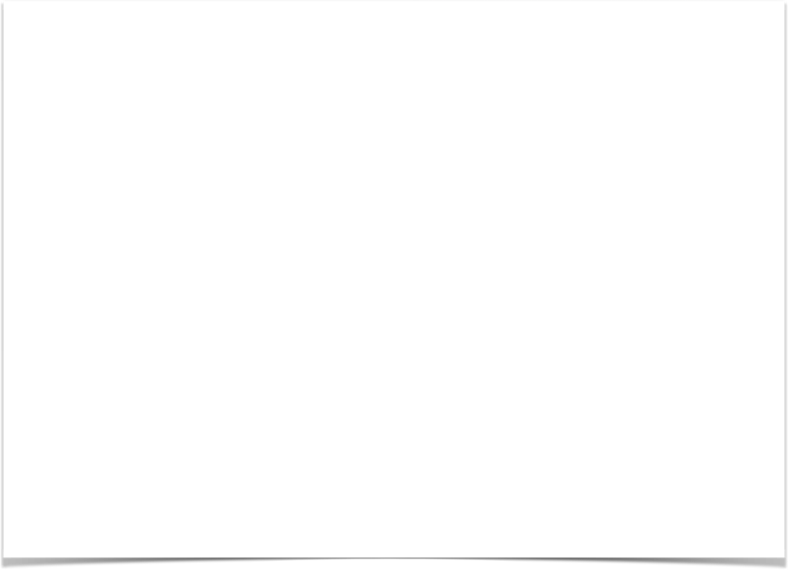
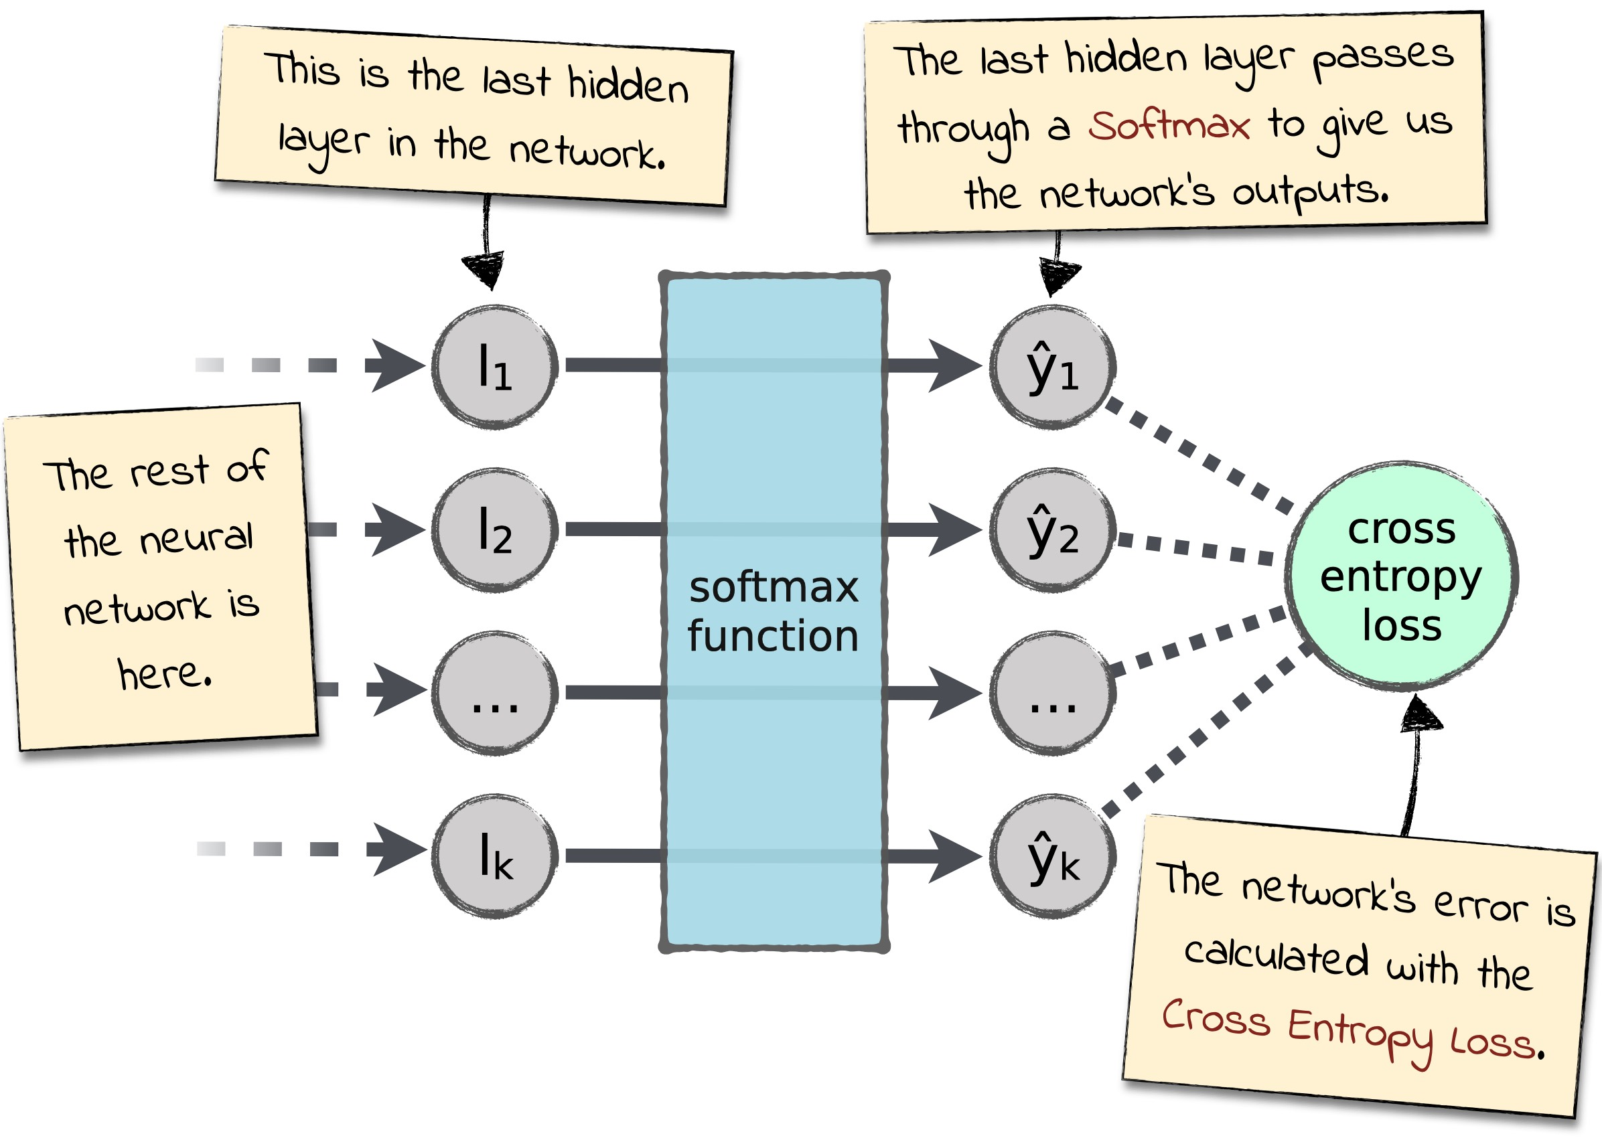
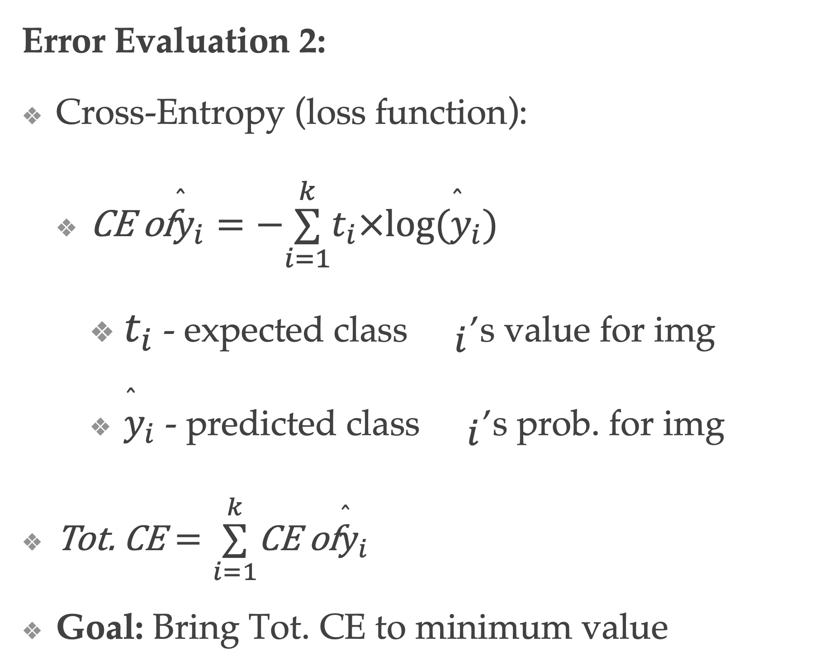
Fully Connected Network
Error Evaluation 2:
Cross-Entropy (loss function):
$\text{CE} \text{of}{\overset{̂}{y}}_{i}=−\overset{k}{\underset{i=1}{∑}}t_{i}×log({\overset{̂}{y}}_{i})$
$t_{i}$ - expected class${}_{i}$’s value for img
${\overset{̂}{y}}_{i}$ - predicted class${}_{i}$’s prob. for img
$\text{Tot}\text{. }\text{CE}=\overset{k}{\underset{i=1}{∑}}\text{CE} \text{of}{\overset{̂}{y}}_{i}$
Goal: Bring Tot. CE to minimum value

Slide 6

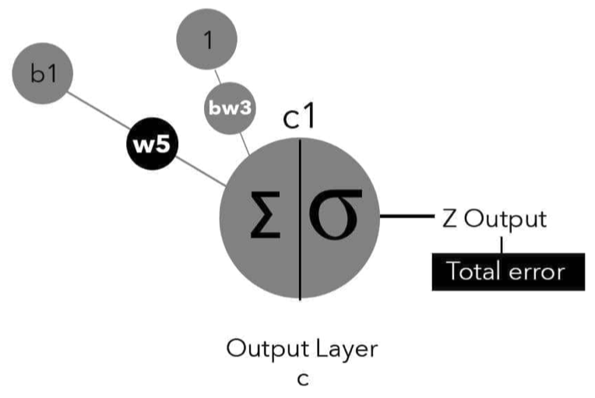
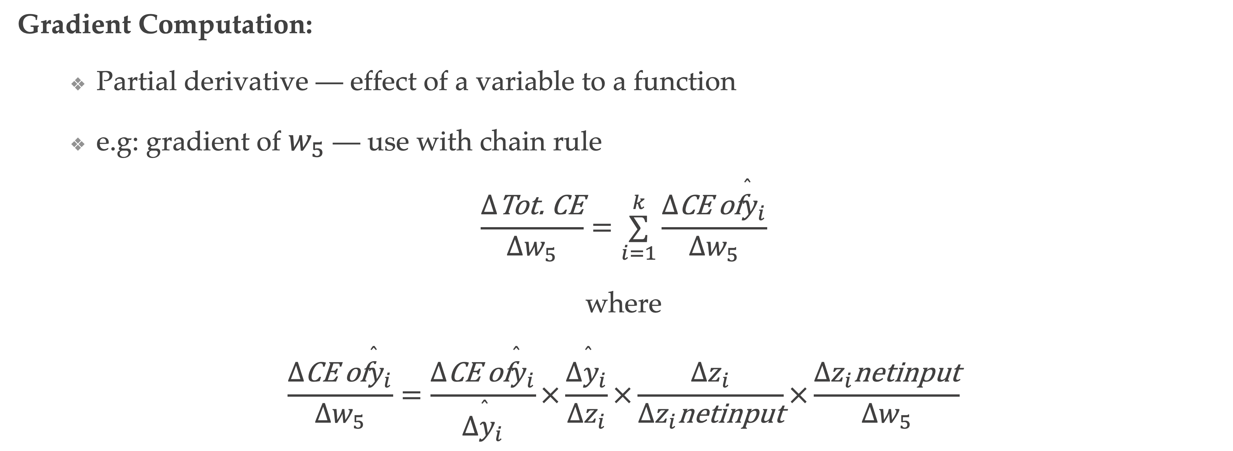
Fully Connected Network
Gradient Computation:
Partial derivative — effect of a variable to a function
e.g: gradient of $w_{5}$ — use with chain rule
$$\frac{Δ\text{Tot}\text{. }\text{CE}}{Δw_{5}}=\overset{k}{\underset{i=1}{∑}}\frac{Δ\text{CE} \text{of}{\overset{̂}{y}}_{i}}{Δw_{5}}$$
where
$$\frac{Δ\text{CE} \text{of}{\overset{̂}{y}}_{i}}{Δw_{5}}=\frac{Δ\text{CE} \text{of}{\overset{̂}{y}}_{i}}{Δ{\overset{̂}{y}}_{i}}×\frac{Δ{\overset{̂}{y}}_{i}}{Δz_{i}}×\frac{Δz_{i}}{Δz_{i}\text{netinput}}×\frac{Δz_{i}\text{netinput}}{Δw_{5}}$$

Slide 7

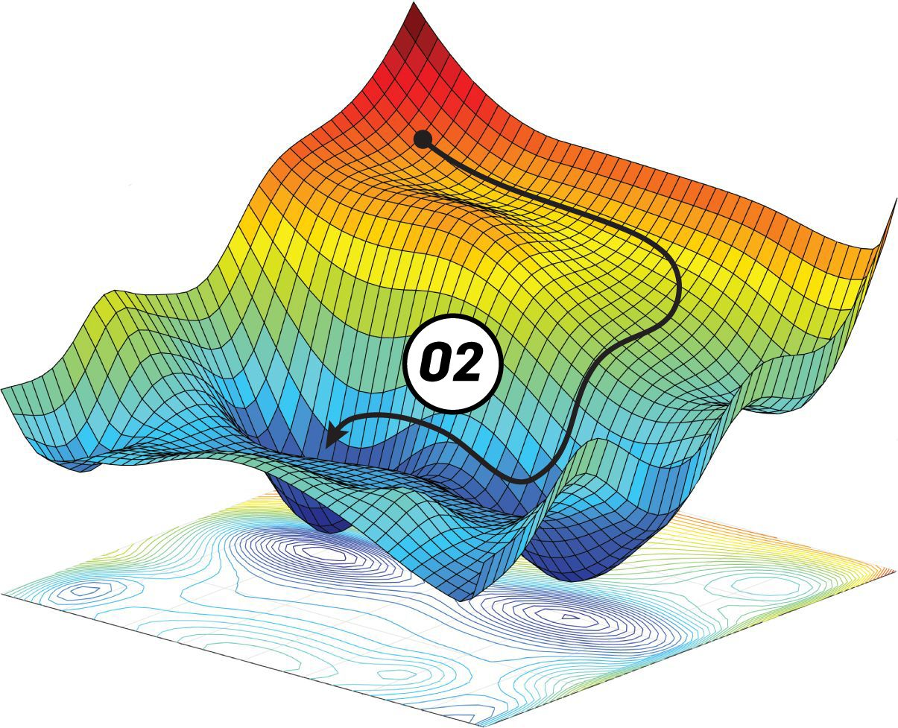
Fully Connected Network
Gradient Descent - Learning:
Step toward global min of Tot. CE
Three GD methods:
Full-Batch GD — guaranteed global min, but slow
Stochastic GD (SGD) — fast, but might never converge
Mini-Batch GD — tradeoff between speed and reliability

Slide 8
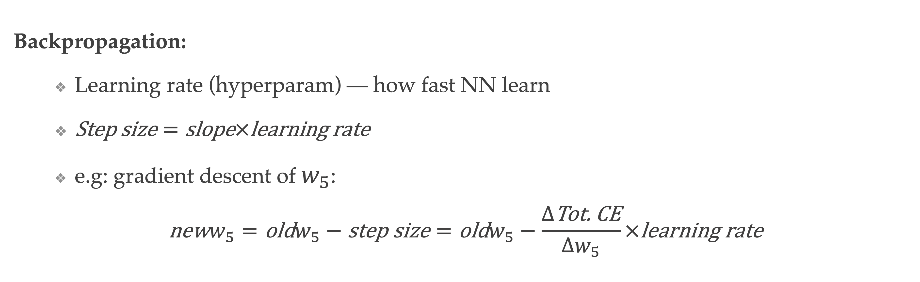
Fully Connected Network
Backpropagation:
Learning rate (hyperparam) — how fast NN learn
$\text{Step} \text{size}=\text{slope}×\text{learning} \text{rate}$
e.g: gradient descent of $w_{5}$:
$$\text{new}w_{5}=\text{old}w_{5}−\text{step} \text{size}=\text{old}w_{5}−\frac{Δ\text{Tot}\text{. }\text{CE}}{Δw_{5}}×\text{learning} \text{rate}$$

Slide 9
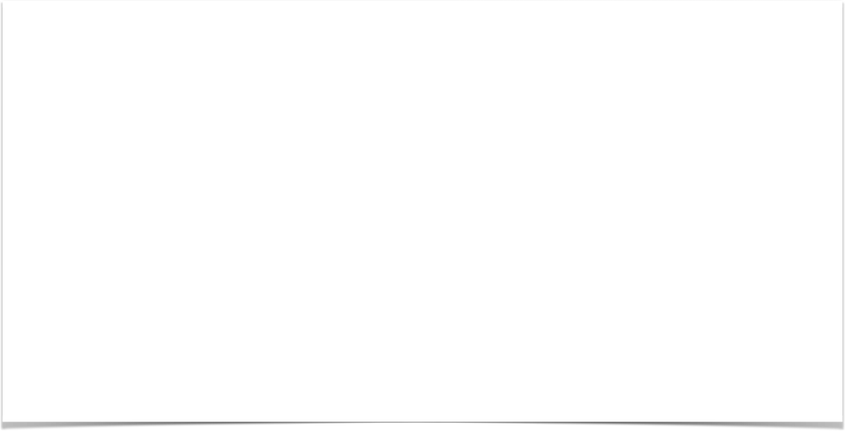
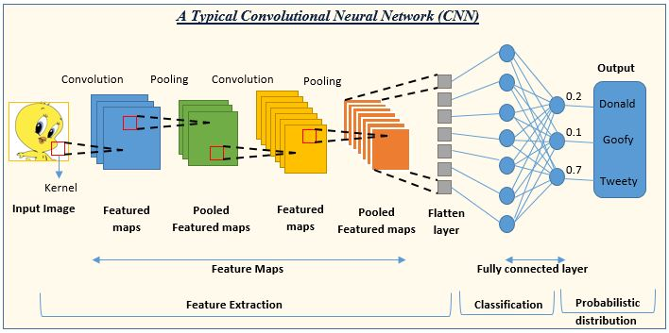
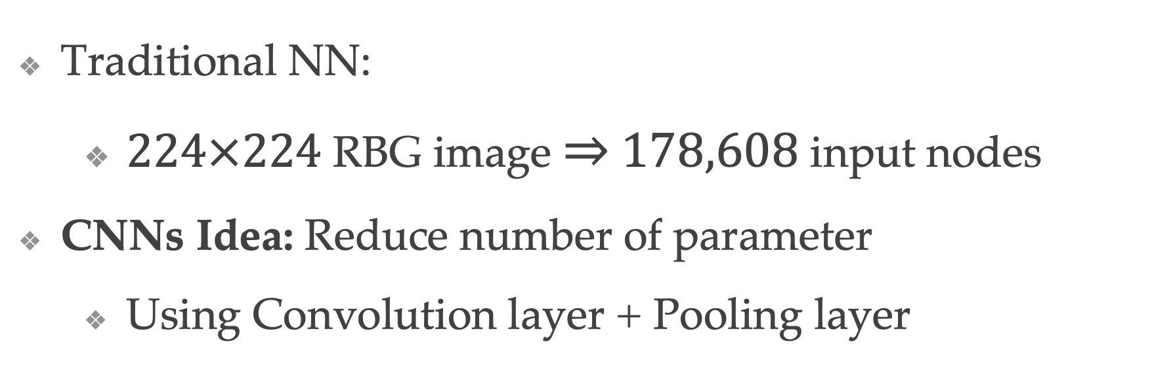
Convolutional Neural Network (CNNs)
Traditional NN:
$224×224$ RBG image $⇒$ $178,608$ input nodes
CNNs Idea: Reduce number of parameter
Using Convolution layer + Pooling layer

Slide 10

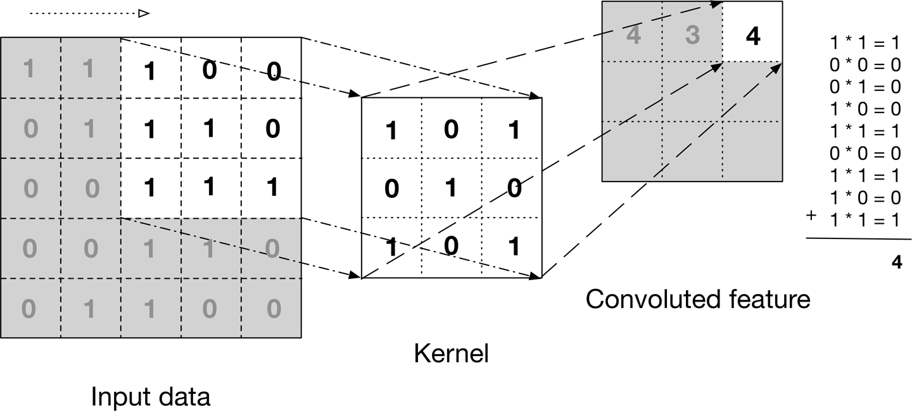

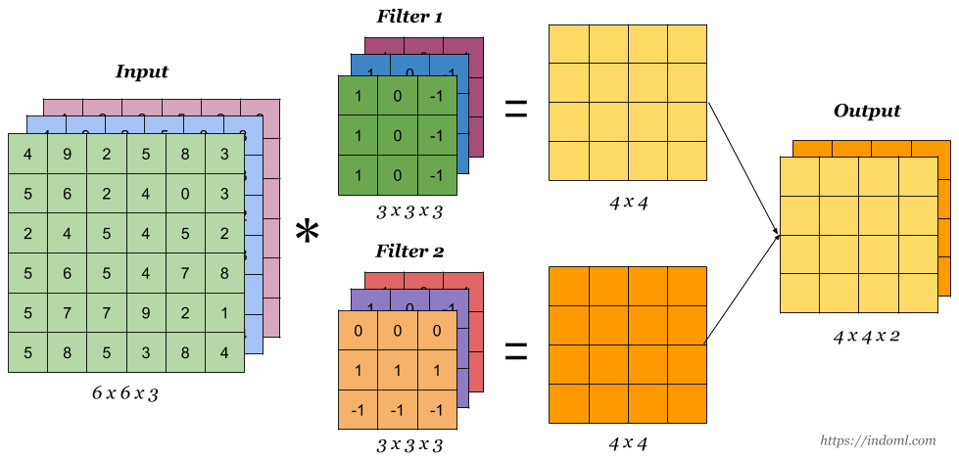
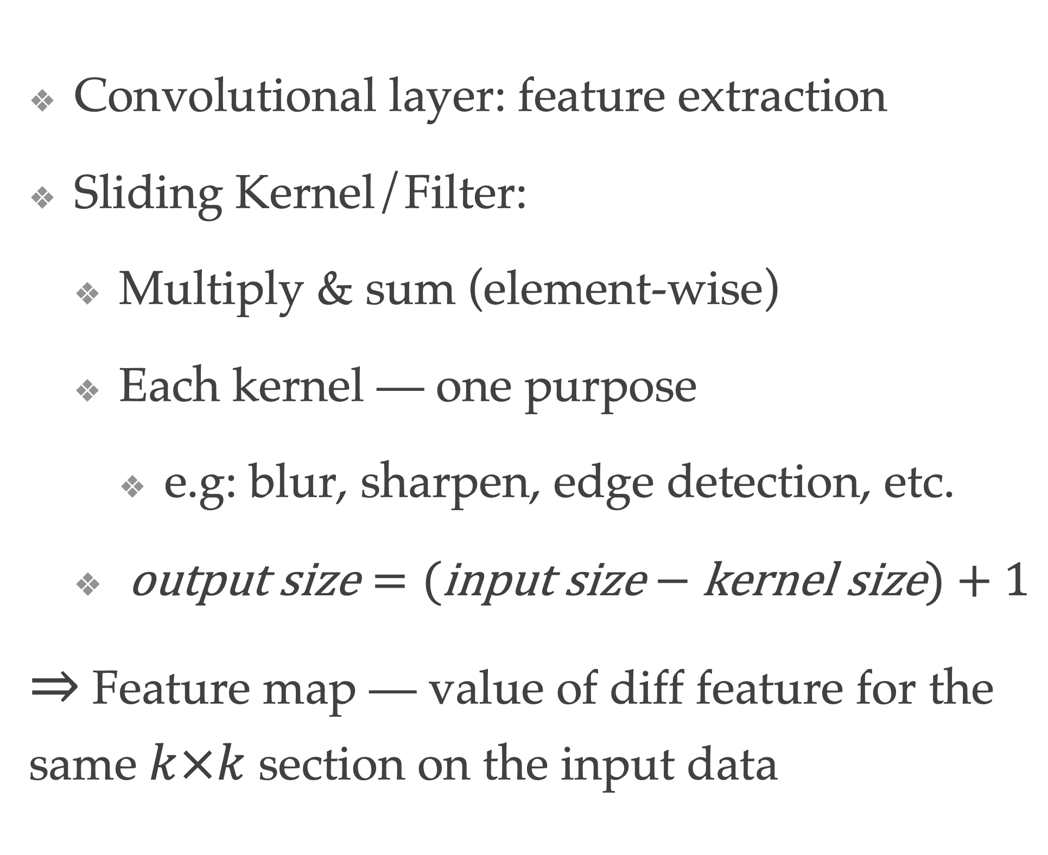
Convolutional Layer
Convolutional layer: feature extraction
Sliding Kernel/Filter:
Multiply & sum (element-wise)
Each kernel — one purpose
e.g: blur, sharpen, edge detection, etc.
$\text{output} \text{size}=(\text{input} \text{size}−\text{kernel} \text{size})+1$
$⇒$ Feature map — value of diff feature for the same $k×k$ section on the input data

Slide 11


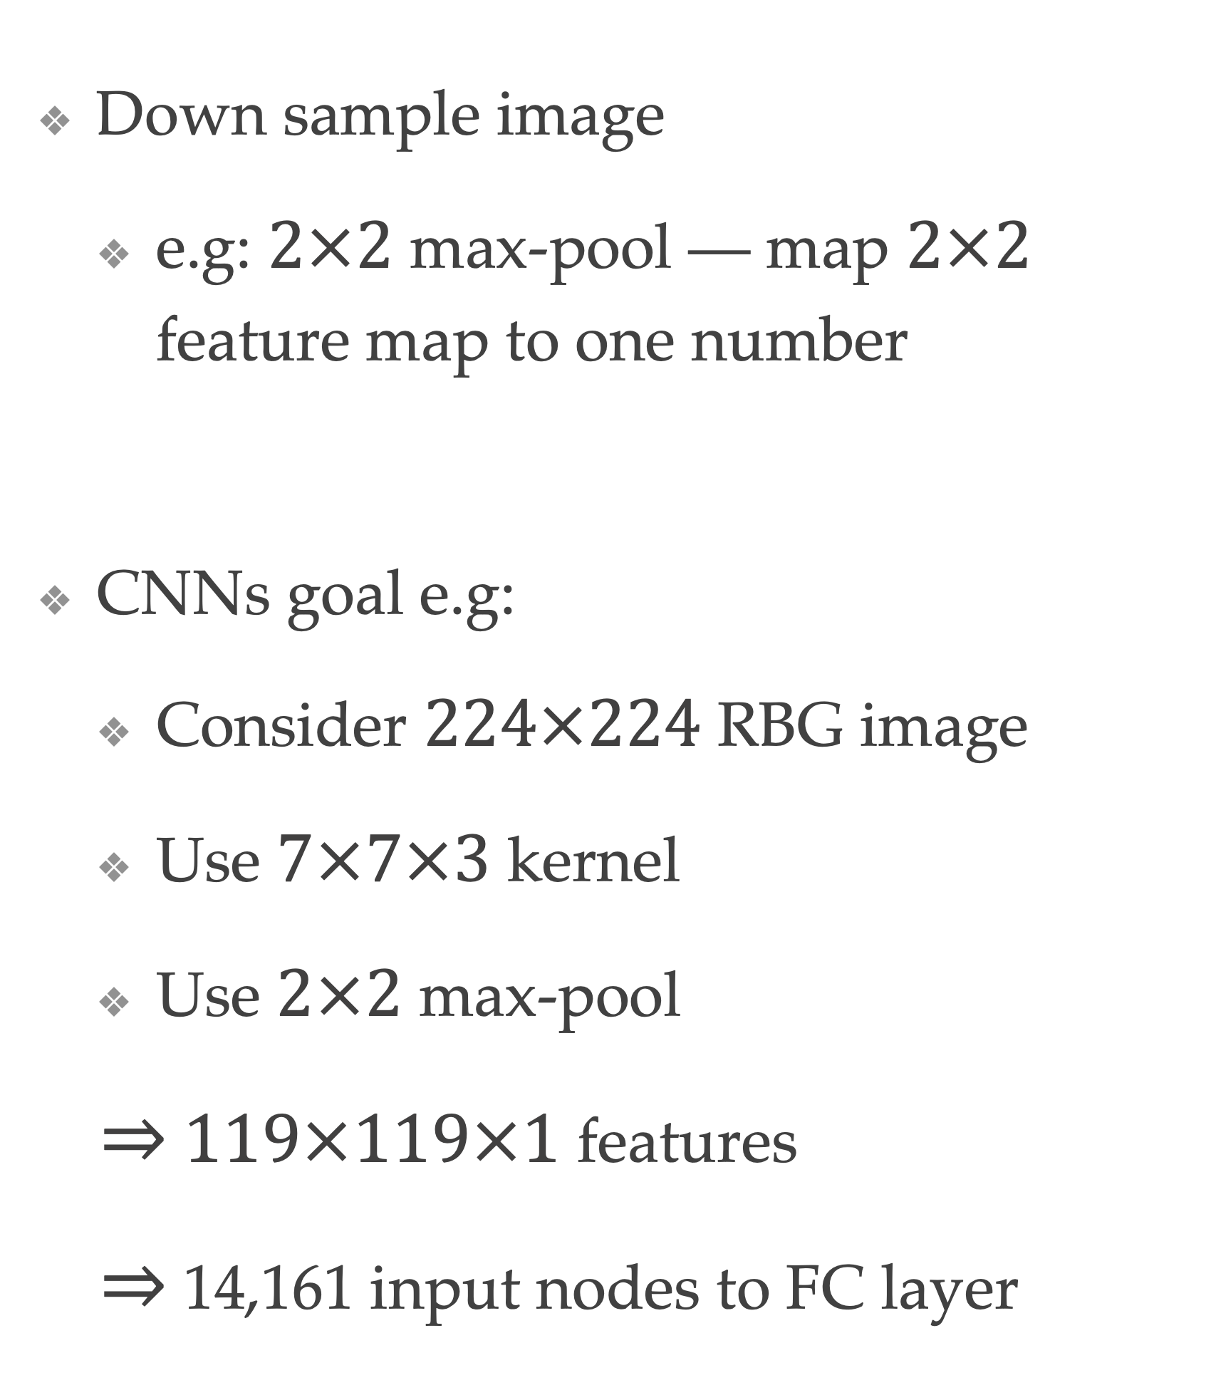
Pooling Layer
Down sample image
e.g: $2×2$ max-pool — map $2×2$ feature map to one number
CNNs goal e.g:
Consider $224×224$ RBG image
Use $7×7×3$ kernel
Use $2×2$ max-pool
$⇒$ $119×119×1$ features
$⇒$ 14,161 input nodes to FC layer

Slide 12

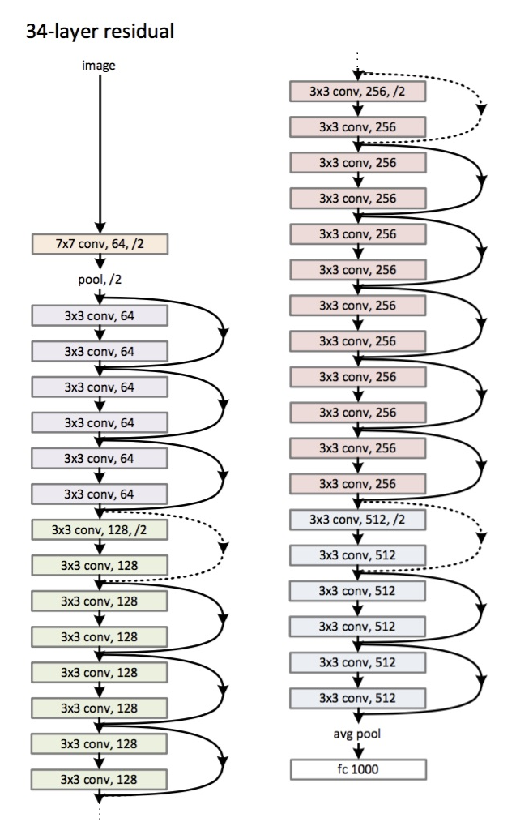
ResNet34
Same structure scale for ResNet50 and ResNet152
Identities shortcut connection
Convolution & pooling layer
Fully connected layers (1000 neurons)
Mini-batch size: 256
Learning rate: 0.1
ReLU activation function

Slide 13
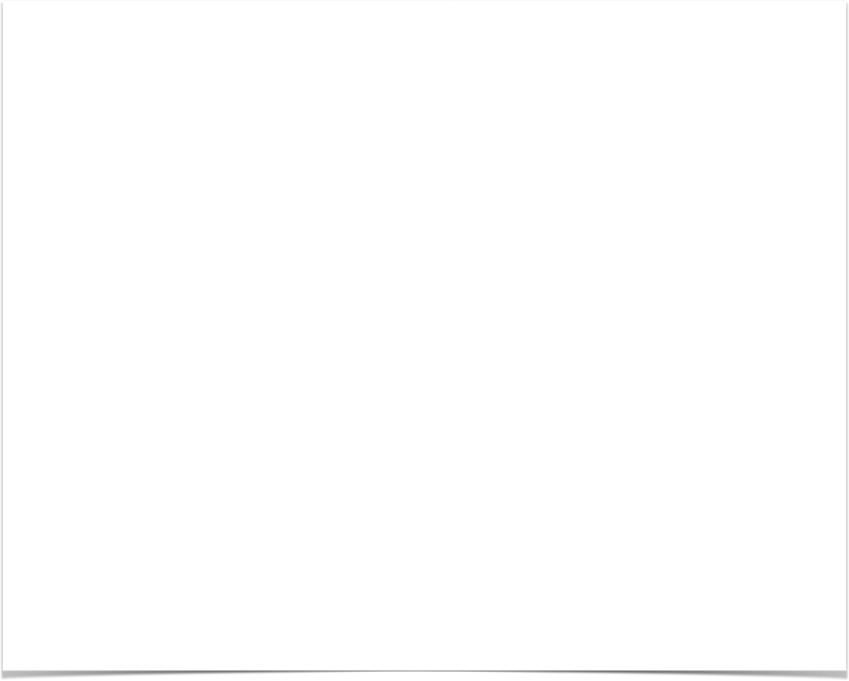
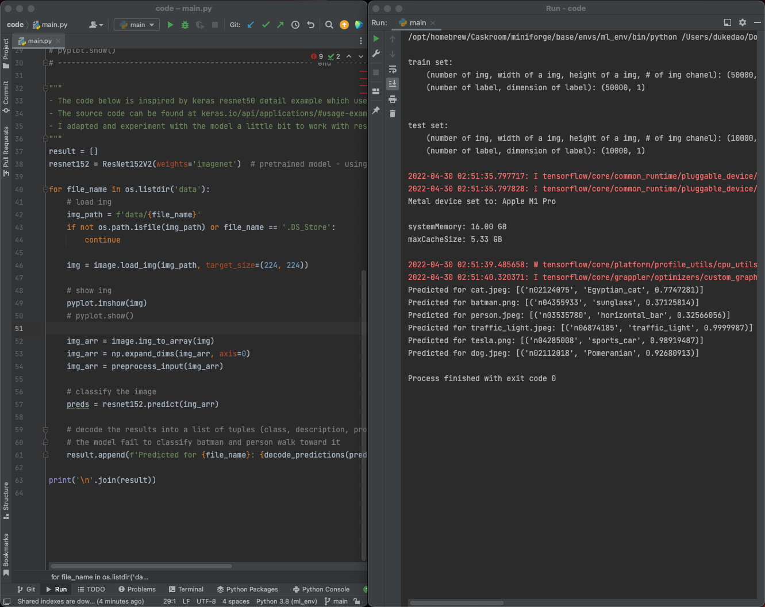
Application
Utilize ResNet152
Use pretrained weights from imagenet
Model suffer with some edge case

Slide 14
Thank You

Slide 15
References
Almabdy, Soad & Elrefaei, Lamiaa. (2019). Deep Convolutional Neural Network-Based Approaches for Face Recognition. Applied Sciences. 9. 4397. 10.3390/app9204397.
Ouaknine, Arthur. “Review of Deep Learning Algorithms for Object Detection.” Medium. Zyl Story, February 5, 2018. https://medium.com/zylapp/review-of-deep-learning-algorithms-for-object-detection-c1f3d437b852.
Follow meAjitesh KumarI have been recently working in the area of Data analytics including Data Science and Machine Learning / Deep Learning. I am also passionate about different technologies including programming languages such as Java/JEE. “What's Softmax Function &amp; Why Do We Need It?” Data Analytics, October 16, 2020. https://vitalflux.com/what-softmax-function-why-needed-machine-learning/.
“Derivative of Cross Entropy The.” derivative of cross entropy The – YCWW. Accessed April 29, 2022. https://www.billicbs.co/derivative-of-cross-entropy-the/.
Gad, Ahmed Fawzy. “Implementing Gradient Descent in Python, Part 2: Extending for Any Number of Inputs.” Paperspace Blog. Paperspace Blog, April 9, 2021. https://blog.paperspace.com/part-2-generic-python-implementation-of-gradient-descent-for-nn-optimization/.

Slide 16
References Con.
Michael Taylor. Neural Networks: A visual introduction for beginners. Blue Windmill Media, 2017.
“Convolutional Neural Network: An Overview.” Analytics Vidhya, March 15, 2022. https://www.analyticsvidhya.com/blog/2022/01/convolutional-neural-network-an-overview/.
Diterbitkan oleh Benny Prijono Lihat semua pos dari Benny Prijono, Diterbitkan oleh Benny Prijono, Benny Prijono, Lihat semua pos dari Benny Prijono, pkab berkata:Juni 14, Pkab Berkata: Benny Prijono berkata:Juni 21, Benny Prijono berkata: Silver berkata: and Nama (wajib). “Student Notes: Convolutional Neural Networks (CNN) Introduction.” Belajar Pembelajaran Mesin Indonesia, April 3, 2018. https://indoml.com/2018/03/07/student-notes-convolutional-neural-networks-cnn-introduction/.
“Papers with Code - Max Pooling Explained.” Explained | Papers With Code. Accessed April 22, 2022. https://paperswithcode.com/method/max-pooling.
Kumar, Dr. Vaibhav. “Mobilenet vs RESNET50 - Two CNN Transfer Learning Light Frameworks.” Analytics India Magazine, June 27, 2021. https://analyticsindiamag.com/mobilenet-vs-resnet50-two-cnn-transfer-learning-light-frameworks/.

